Slide 1
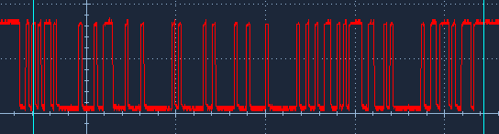
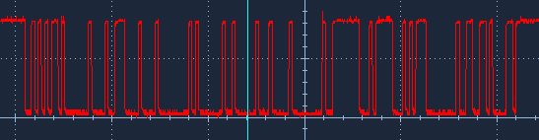
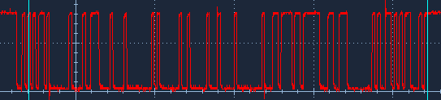

Slide 2
Invertido

Slide 3
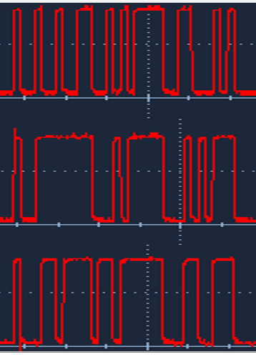

Slide 4
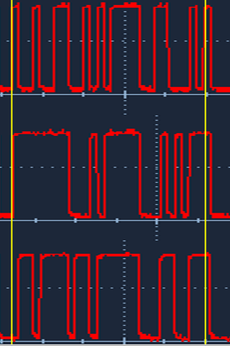
Tarjeta |  |  | HEX |  |  |  | DEC |  |  |  | BIN
X |  |  | 46EA92 |  |  |  | 4647570 |  |  |  | 0100 0110 1110 1010 1001 0010
ok |  |  | D4 F4FE |  |  |  | 13956350 |  |  |  | 1101 0100 1111 0100 1111 1110
Z |  |  | CC FBEC |  |  |  | 13433836 |  |  |  | 1100 1100 1111 1011 1110 1100

Slide 5
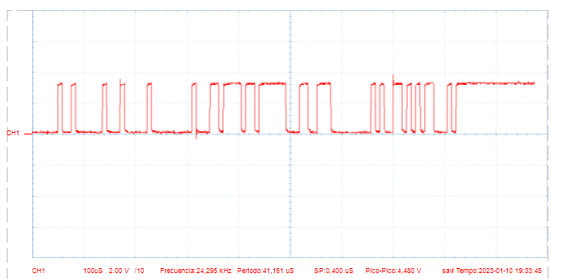

Slide 6
